Slide 1
Name: Ghinaiya Deep Amulbhai
Class: MCA-I Div: A (5119)
Roll No: WD03
Subject: MPR541MRP- Mini Project
Project Title: StudySphere: Student Learning Platform

Slide 2
Project Title:
StudySphere: Student Learning Platform
Explore the best resources for your learning journey

Slide 3
Abstract:
StudySphere is a web-based online study portal developed using the Django framework of Python. It provides students with a centralized platform to manage their study activities efficiently. The system includes features like Notes, Homework, To-Do List, Books, Dictionary, Wikipedia, YouTube integration, and Conversion tools.
The main aim of StudySphere is to enhance students’ productivity and make their learning experience more organized, interactive, and accessible from one place. Basically, it is a centralized hub for students to access various educational resources.

Slide 4
Introduction
StudySphere is an educational web platform designed to simplify and improve the way students handle their academic tasks. Built using the Django framework, it focuses on providing all essential study tools under a single portal.
Students can take notes, manage homework, set tasks, and access educational content like books, videos, and dictionaries without switching between different platforms. Its clean and user-friendly interface ensures that students of any level can use it easily.
The platform offers eight key features:
Notes
Homework
YouTube
To-Do List
Books
Dictionary
Wikipedia
Conversions

Slide 5
Problem Definition
Students struggle to keep their study materials, notes, and assignments organized, often leading to wasted time searching for resources.
Many existing educational tools focus on only one aspect (like note-taking or homework tracking) and fail to provide an integrated solution.
Lack of centralized access to all learning materials causes students to miss deadlines or overlook important topics.
Manual tracking of homework and tasks increases the risk of incomplete assignments and poor academic performance.
Collaboration and sharing among peers is limited in traditional systems, reducing the opportunity for collective learning.
Students often use multiple apps and platforms, which can be confusing and inefficient, leading to fragmented learning experiences.

Slide 6
Need of the System
To enhance students’ productivity by providing a structured and distraction-free environment for learning.
To allow students to track homework, assignments, and deadlines in one centralized dashboard.
To simplify the process of creating, editing, and organizing digital notes for different subjects.
To improve collaboration by allowing students to share notes and resources securely.
To ensure data privacy and protect study materials from unauthorized access.
To provide reminders and notifications for upcoming tasks or exams.
To create a user-friendly interface that makes navigation and management easy for all users.
To enable cloud-based storage so students can access their data across multiple devices.
To reduce dependency on paper-based notes, promoting eco-friendly learning.
To continuously improve learning habits through progress tracking and analytics.

Slide 7
Objectives
Centralized Study Platform:
To provide students with one platform where they can manage all study-related tasks like notes, homework, and to-do lists.
Enhance Student Productivity:
Helps students stay organized, manage time better, and complete tasks without missing deadlines.
User-Friendly Interface:
Designed with a simple and clean layout so students can easily navigate and use all features without confusion.
Integration of Study Tools:
Combines multiple learning tools such as YouTube, Dictionary, Wikipedia, and Conversions into a single platform.
Improved Access to Resources:
Allows quick and easy access to study materials, books, and videos anytime and anywhere.
Support for Online Learning:
Encourages digital and remote learning by providing a web-based study solution accessible from any device.
Efficient Task Management:
Enables students to track homework, create to-do lists, and manage academic goals effectively.

Slide 8
Scope of the Project
Student-Centered Platform
Designed especially for students at different academic levels.
All-in-One Study System
  Combines features like Notes, Homework, To-Do List, Books, YouTube, Dictionary, Wikipedia, and Conversions.
Web-Based Access
Can be used on desktops, laptops, tablets, and mobile devices anytime, anywhere.
User-Friendly Interface
Simple design that makes learning and navigation easy for all users.
Secure and Reliable
Uses secure login and data protection to keep student information safe.
Focused on Students Only
No teacher or admin access — fully designed for students to manage their study work.
Digital Learning Support
Encourages online and self-paced learning through easy access to study materials.
Easy Maintenance
  The system is designed to be easily updated and maintained over time.
Future Enhancements
Plans to add AI-based suggestions, gamification, and mobile app integration for better learning experience.

Slide 9
Hardware and software requirement
Hardware Requirements:
Operating System: Windows 10/11, macOS or Linux
Web Browser: Chrome, Firefox, or Edge for testing and debugging the web application.
Development Tools: Visual Studio Code.
Database Management: SQLite.
Python Version: Python 3.x (preferably 3.10 or higher) for Django development.
Django Framework: Latest stable version of the Django web framework.
Frontend Development: HTML5, CSS3, and JavaScript, Bootstrap for front-end web development.
Package Management: pip for managing Python dependencies.
Software Requirements:
Processor: Minimum: Intel i5 / Ryzen 5 | Recommended: Intel i7 / Ryzen 7
RAM: Minimum 8GB | Recommended 16GB
Storage: Minimum 100GB | Recommended SSD
Graphics: Integrated graphics (sufficient) | Dedicated GPU optional
Internet: Stable broadband connection
Display: Minimum 13" FHD (1920×1080) | Recommended 15"+ screens

Slide 10
Project Module Description
Notes Management Module:
Purpose:
This module allows students to manage, view, academic notes uploaded by the admin.
Key Features:
    Students can view a list of notes categorized by subjects or topics.
    Download notes for offline access.
    Option for admin to upload new notes or update existing ones.
2. Homework Management Module:
Purpose:
This module enables students to receive and manage homework assignments.
Key Features:
    Admin can create and assign homework tasks with due dates.
    Students can view the assigned homework and its deadline.
    Option for students to mark homework as completed.

Slide 11
3. YouTube Integration Module:
Purpose:
This module allows students to access educational YouTube videos directly from the StudySphere platform.
Key Features:
    Students can view these videos within the platform.
    Option to search and filter videos by subject or topic.
    Video recommendations based on students' interests and subjects.
4. To-Do List Module:
Purpose:
The To-Do List module helps students organize their daily tasks and study goals.
Key Features:
    Students can add tasks with descriptions, deadlines, and priorities.
    The platform allows students to mark tasks as completed or pending.
    Option to categorize tasks into different categories (e.g., homework, study, personal).

Slide 12
5. Books Module:
Purpose:
This module offers students access to a library of recommended books, both online and offline.
Key Features:
    Students can search for books based on titles, authors, or subjects.
6. Dictionary Module:
Purpose:
The Dictionary module provides students with a quick and easy way to look up word definitions and meanings.
Key Features:
    Option to search for definitions, synonyms, and antonyms.
    Audio pronunciation for better learning.
7. Wikipedia Integration Module:
Purpose:
This module allows students to access Wikipedia articles on various topics directly from the platform.
Key Features:
    Students can search for articles or browse a list of curated topics.

Slide 13
8. Conversions Module:
Purpose:
The Conversions module helps students perform various unit conversions, such as currency, measurements, temperature, etc.
Key Features:
    The platform will display the converted results instantly.
    Option to select units for conversion (e.g., pounds to kilograms, Celsius to Fahrenheit).
9.User Authentication and Profile Module:
Purpose:
This module handles student authentication and user profile management.
Key Features:
    Students can register, log in, and update their profiles (e.g., name, profile picture, etc.).
    Secure authentication using JWT or Django’s built-in authentication system.
    Password recovery and account management.

Slide 14
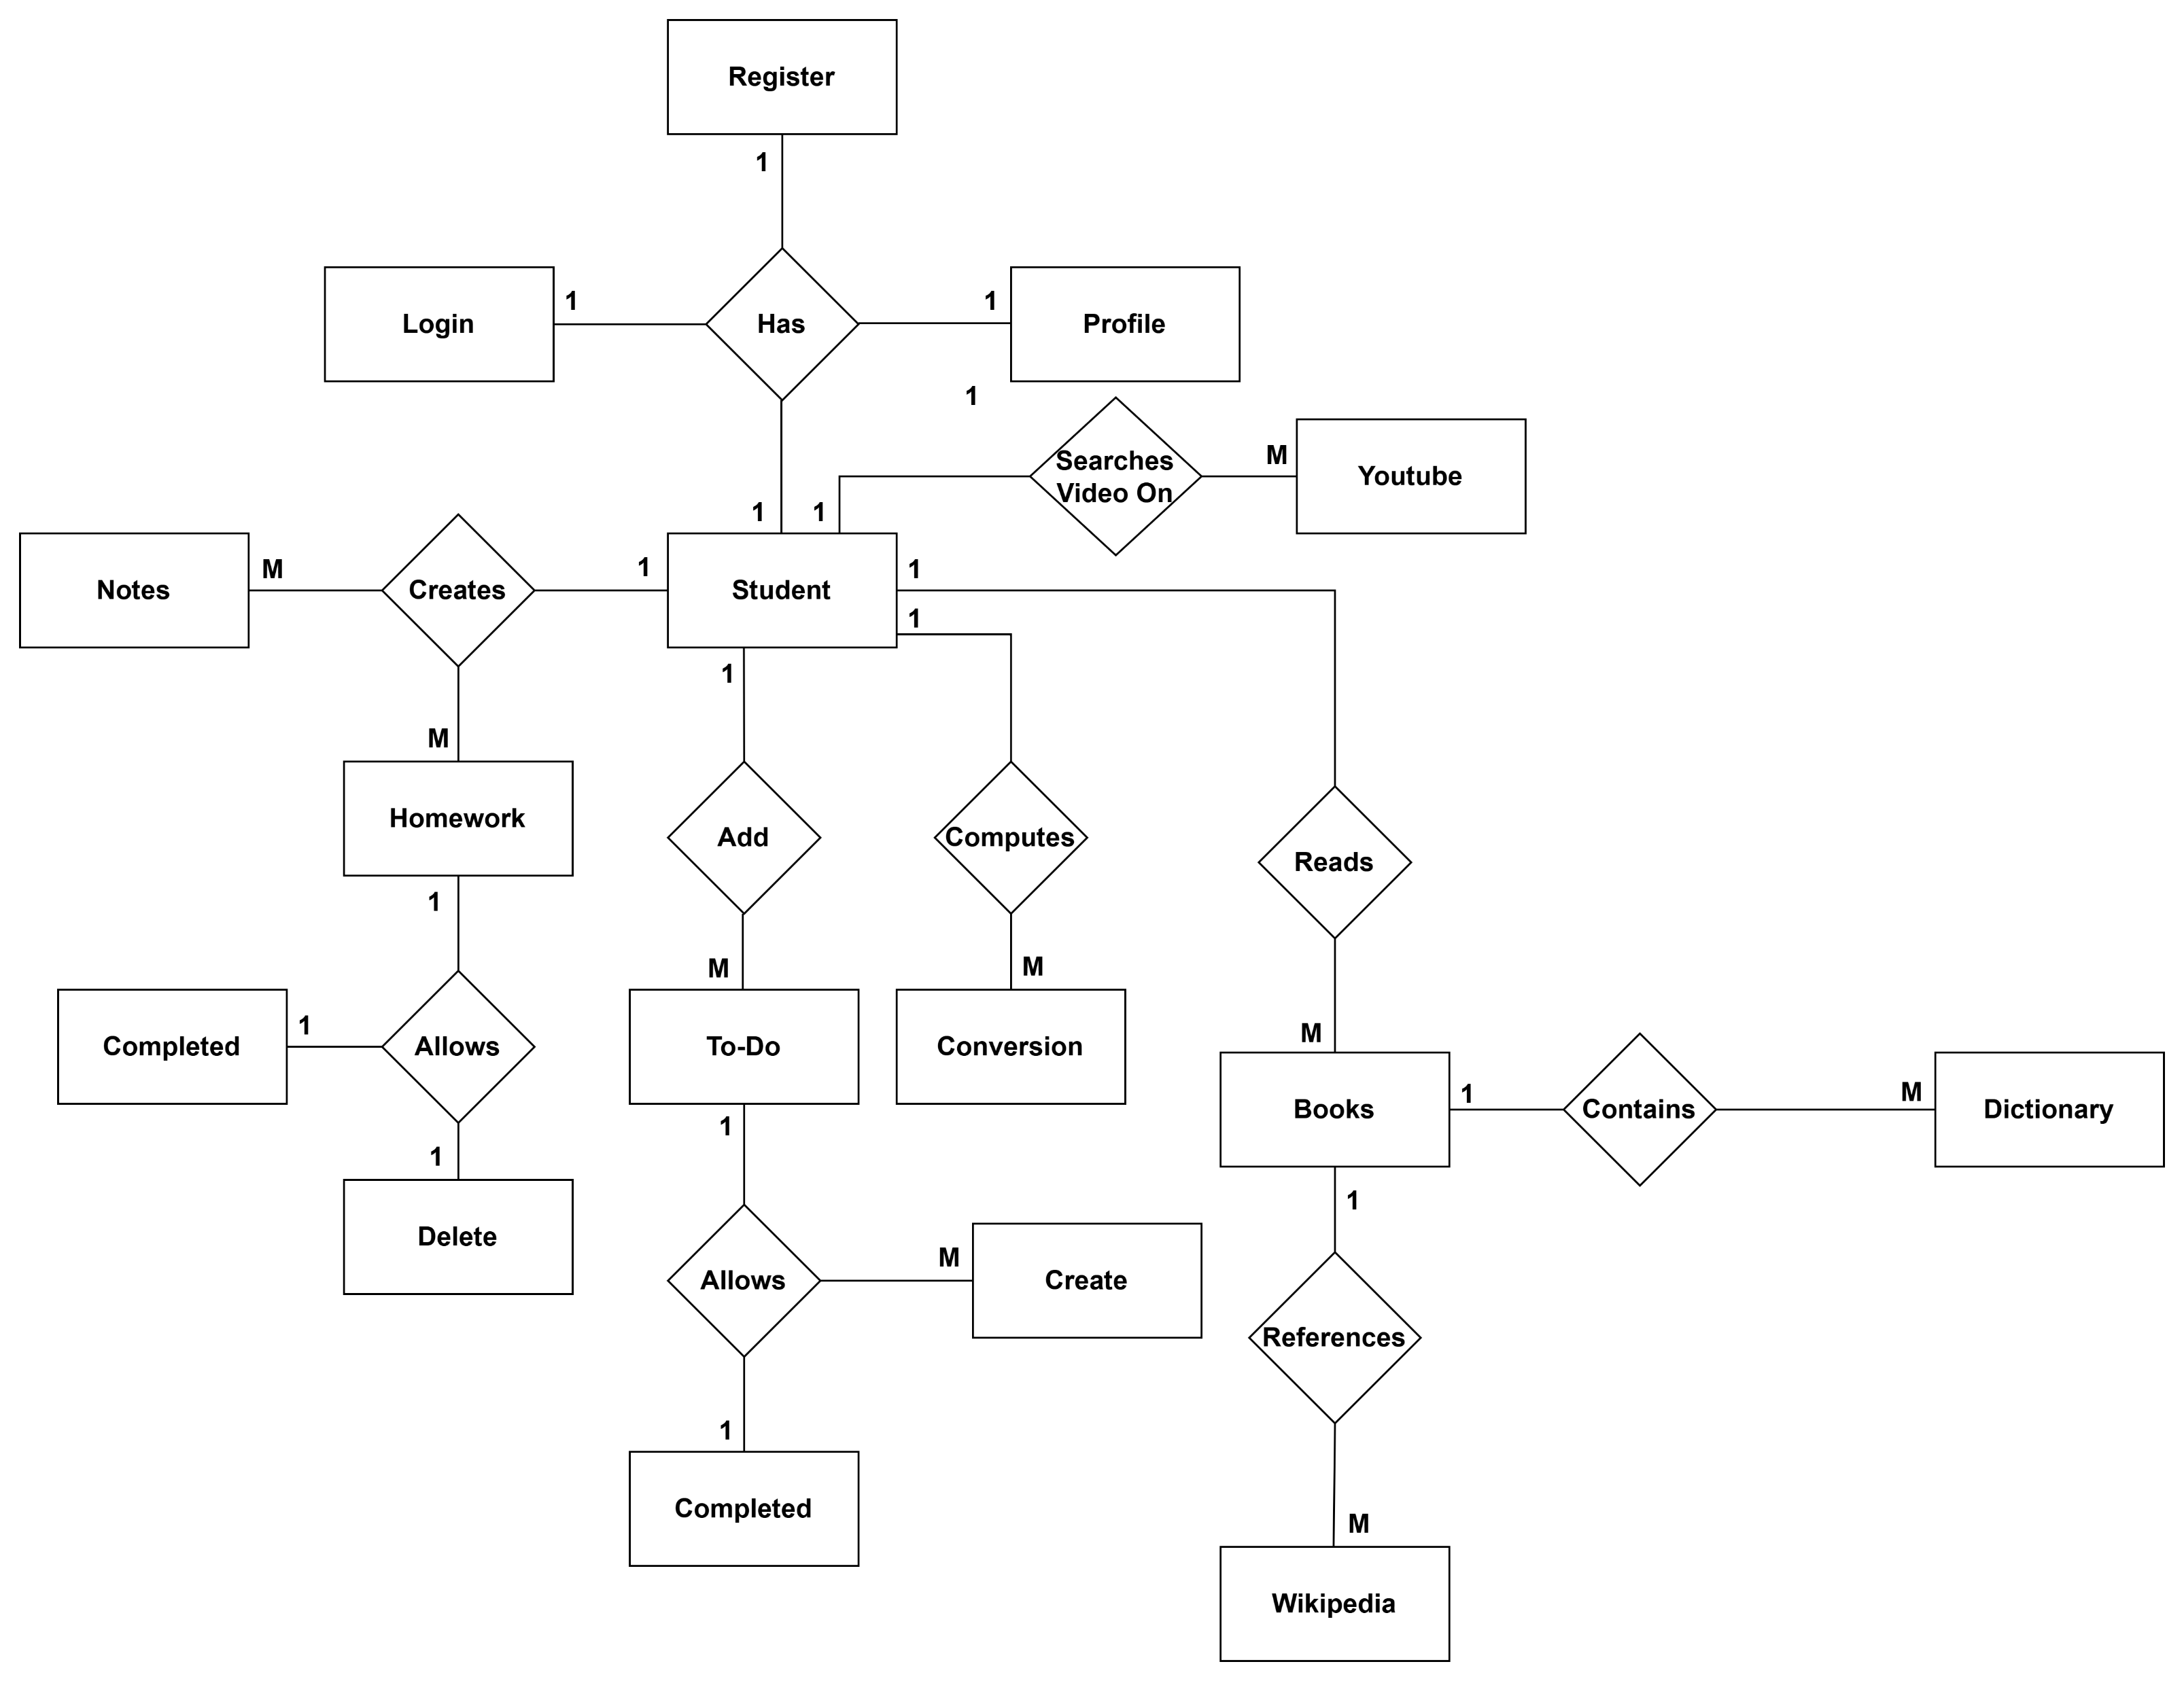
System Model ERD

Slide 15
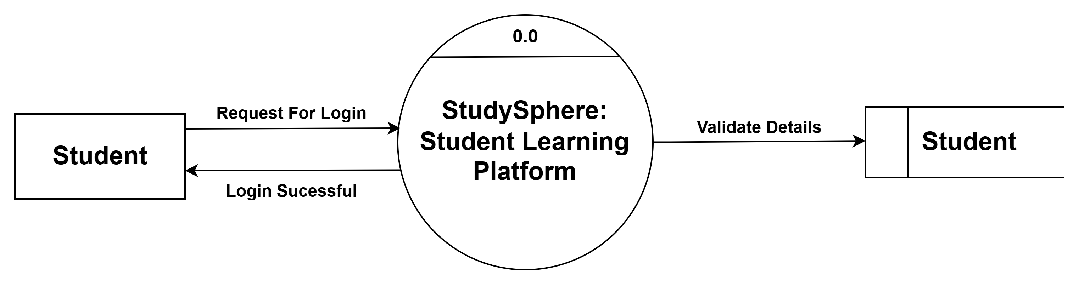
Data Flow Diagrams
1. Context Level DFD:

Slide 16
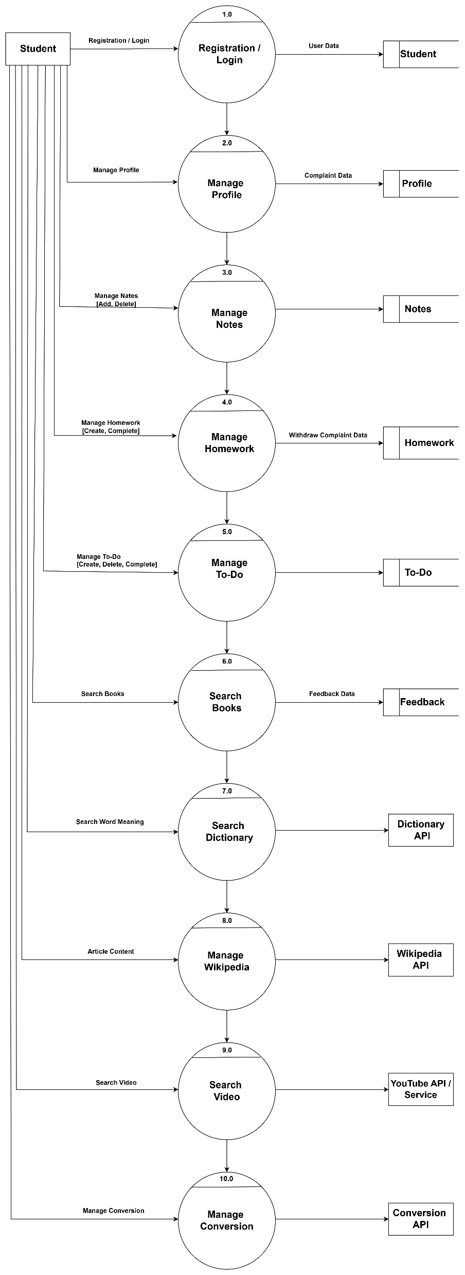
2. First Level dfd

Slide 17
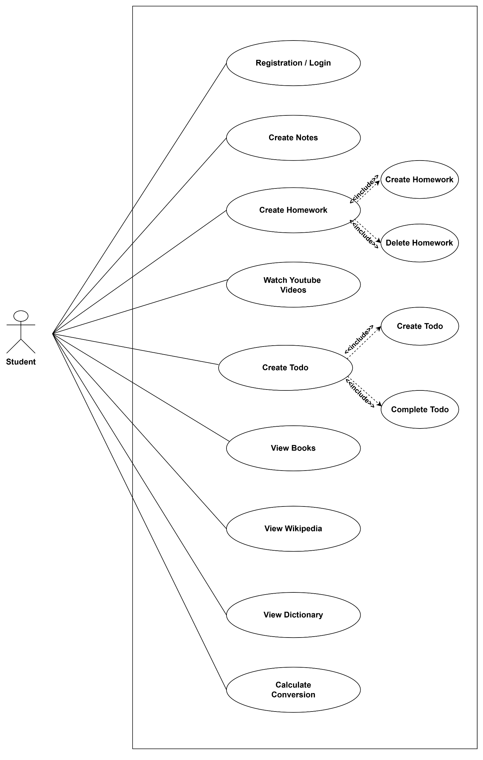
UML Diagrams
1. Use case diagram:

Slide 18
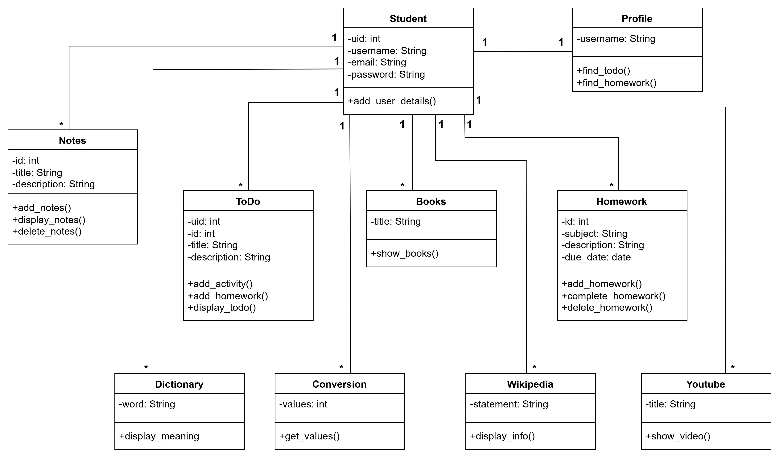
2. Class diagram:

Slide 19
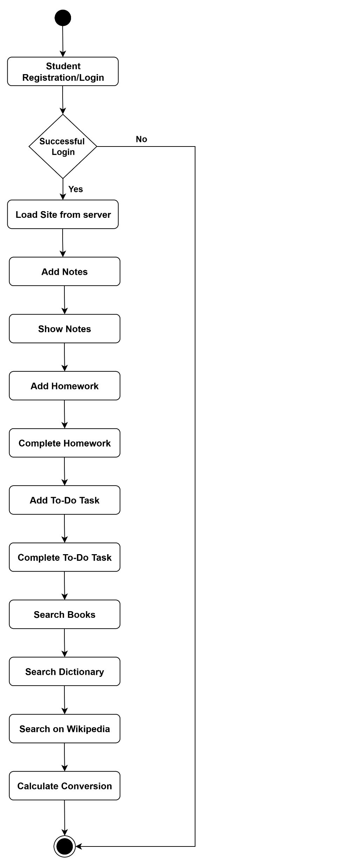
3. Activity diagram:

Slide 20
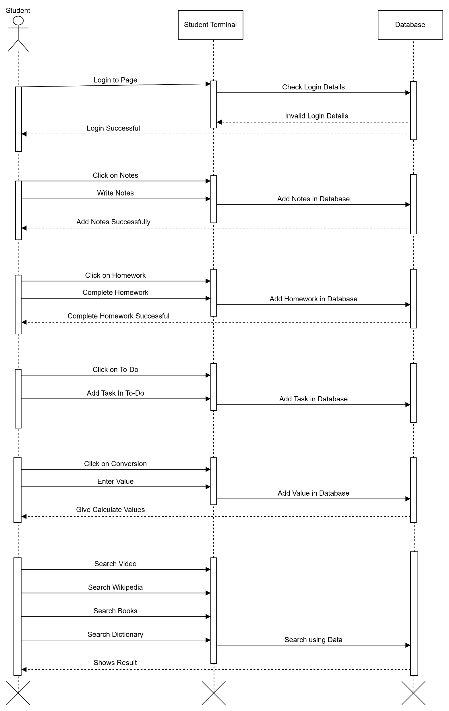
4. Sequence diagram:

Slide 21
Database Design
Student Table
Attribute | DataType | Size | Constraints | Description
uid | Integer | 11 | Primary Key | Student Id
name | Varchar | 30 | - | Name of Student
email | Varchar | 30 | - | Email of Student
password | Varchar | 10 | - | Password of Student
Notes Table
Attribute | DataType | Size | Constraints | Description
id | Integer | 11 | Primary Key | Id of Notes
title | Varchar | 30 | - | Title of Notes
description | Varchar | 200 | - | Content of Notes
uid | Varchar | 11 | Foreign Key | Student Id

Slide 22
Homework Table
Attribute | DataType | Size | Constraints | Description
id | Integer | 11 | Primary Key | Id of Homework
subject | Varchar | 30 | - | Title of Subject
title | Varchar | 30 | - | Title of Homework
descripton | Varchar | 2000 | - | Description of Homework
due date | Date | - | - | Due Date of Homework
uid | Integer | 11 | Foreign Key | Student Id
To-Do Table
Attribute | DataType | Size | Constraints | Description
id | Integer | 11 | Primary Key | Id of To-Do
title | Varchar | 30 | - | Title of To-Do
description | Varchar | 2000 | - | Content of To-Do
uid | Varchar | 11 | Foreign Key | Student Id

Slide 23
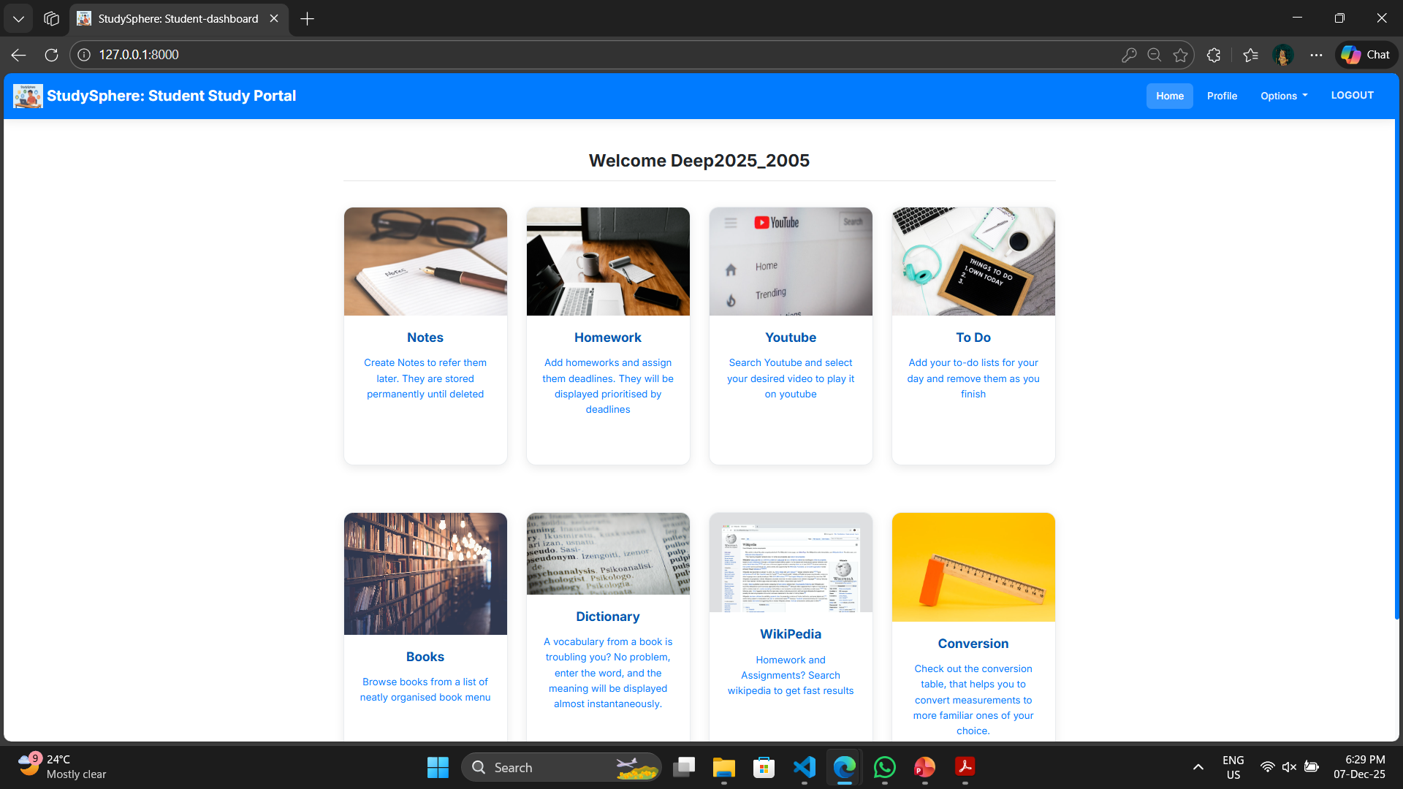
prototype

Slide 24
Thank You…………………..

